Slide 1
Elements and Principals of ART and DESIGN
Content for your accordion book and art projects

Slide 2
What are they?
Elements of Art
Parts that make up a piece
Structure
Line, shape, form, space, value, texture, color
Principals of Design
Concepts
They affect content and the message
Balance, emphasis, movement, pattern, rhythm, contrast and unity

Slide 3
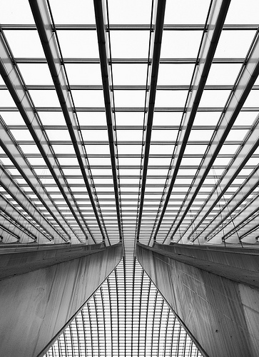
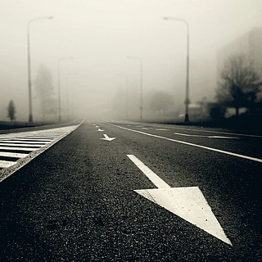
Line

Slide 4
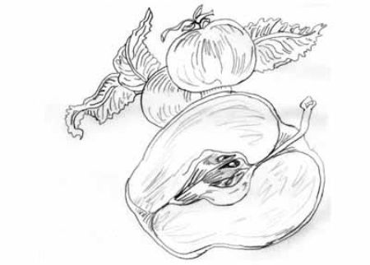
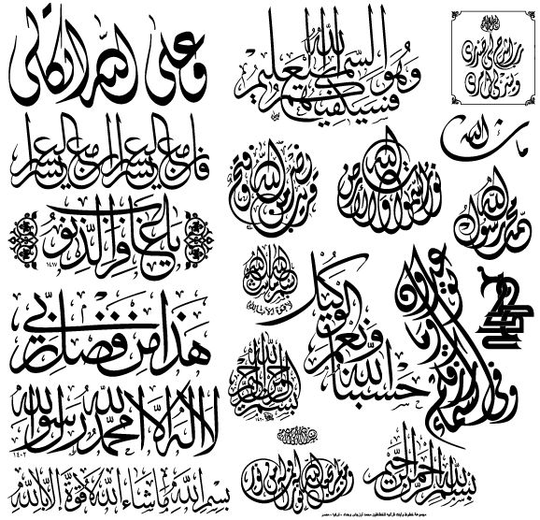
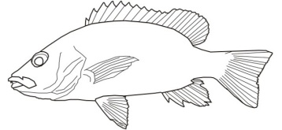
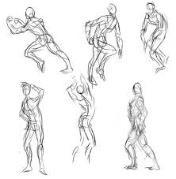
Line
Line: used to define shape, contours, and outlines, also to suggest mass and volume. It may be a continuous mark made on a surface with a pointed tool or implied by the edges of shapes and form
Characteristics: Width, length, direction, focus, feeling
Types: Outline, Contour, Gesture, Sketch, Calligraphic, Implied

Slide 5
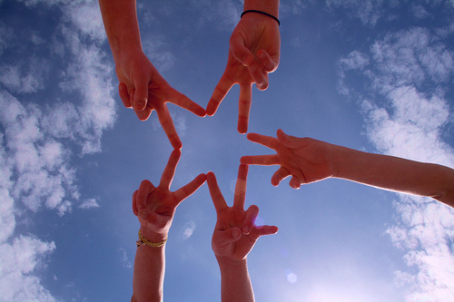
Shape

Slide 6
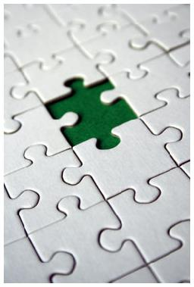
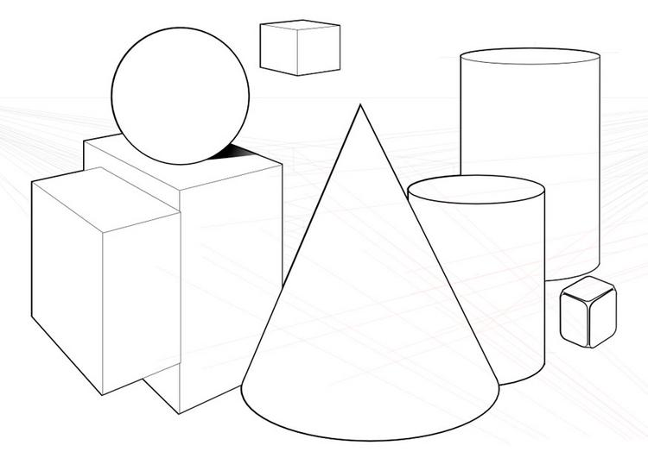
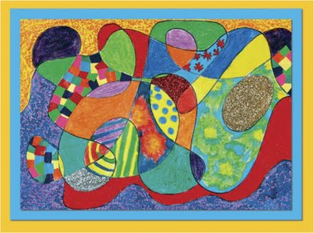
Shape
Shape: When a line crosses itself or intersects with other lines to enclose a space it creates a shape. Shape is two-dimensional it has heights and width but no depth.
Types of Shape: Geometric, Organic, Positive, Negative,

Slide 7
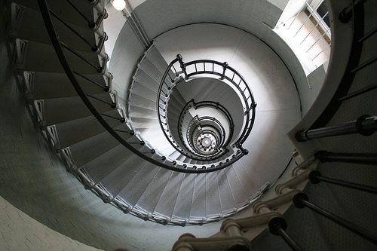
Space

Slide 8
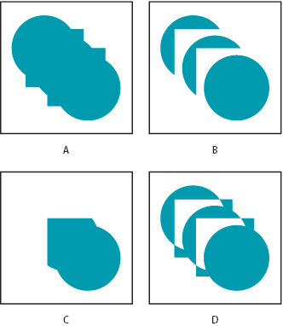
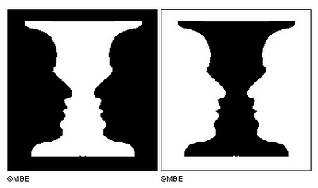
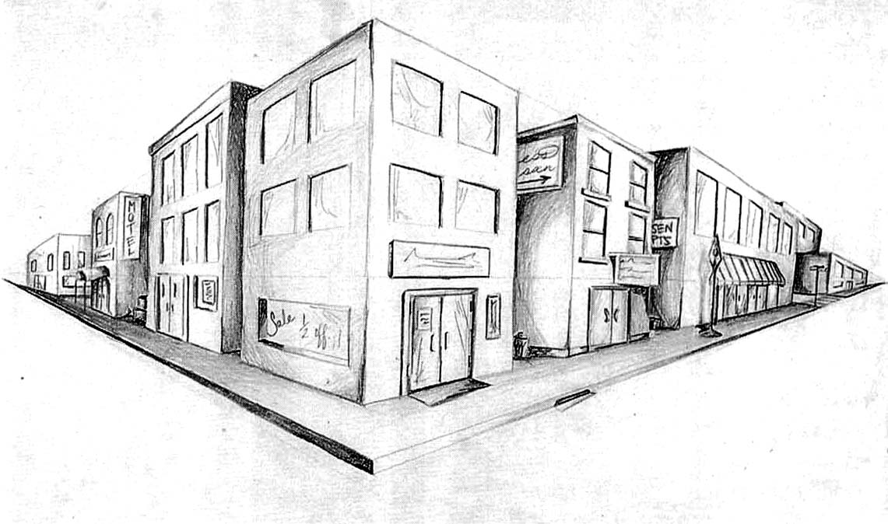
Space
Space: Space is the three-dimensionality of a sculpture. With a sculpture or architecture you can walk around them, look above them, and enter them, this refers to the space of the sculpture or architecture. A three-dimensional object will have height, width, and depth
Types of Space: Positive, Negative, Perspective, Position placing, and overlapping

Slide 9
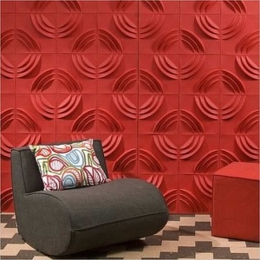
Form

Slide 10
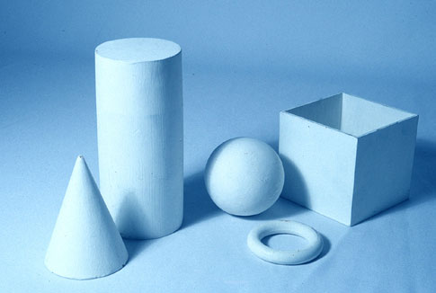
Form
Form: is the three-dimensionality of an object. Shape is only two-dimensional; form is three-dimensional. You can hold a form; walk around a form and in some cases walk inside a form. In drawing or painting using value can imply form. Shading a circle in a certain manner can turn it into a sphere.

Slide 11
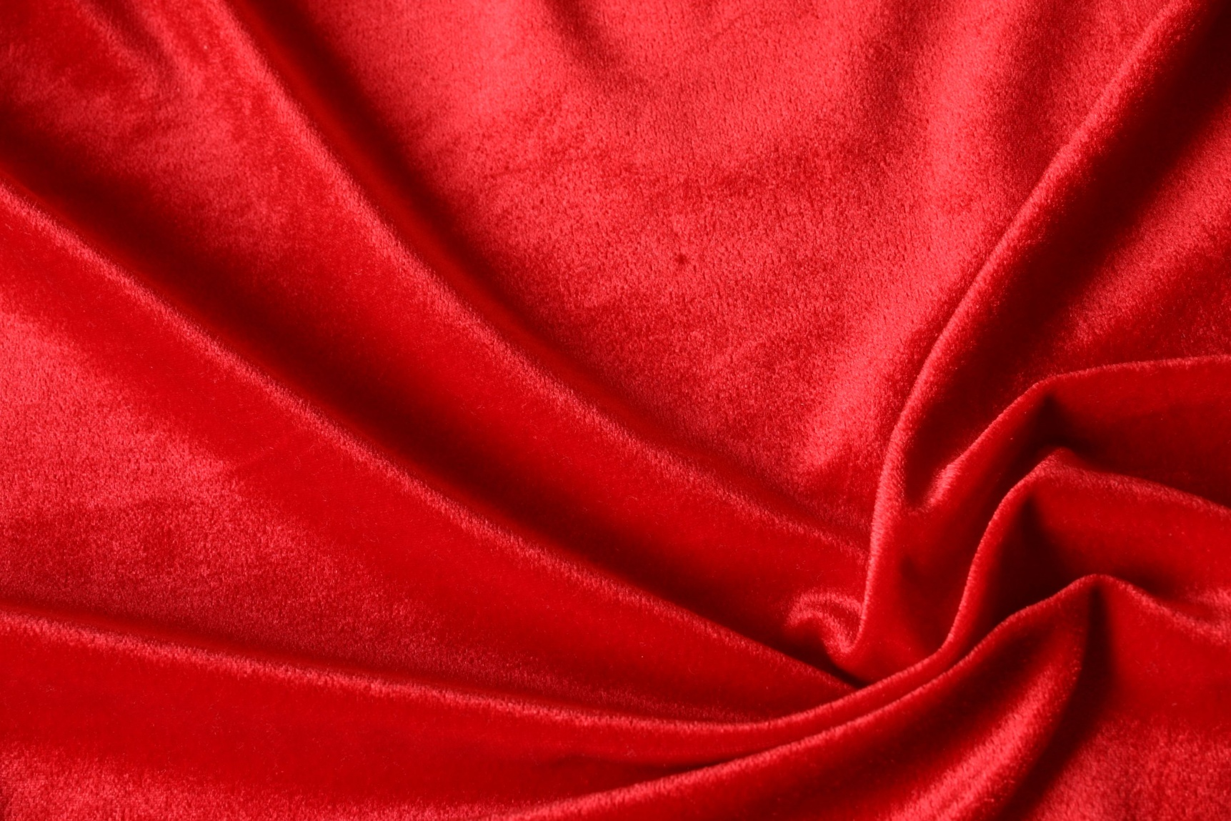
Texture

Slide 12
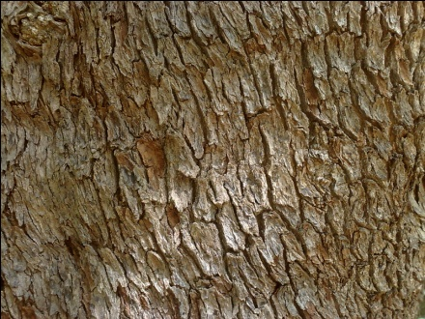
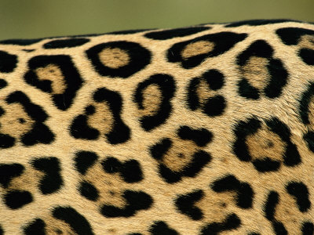
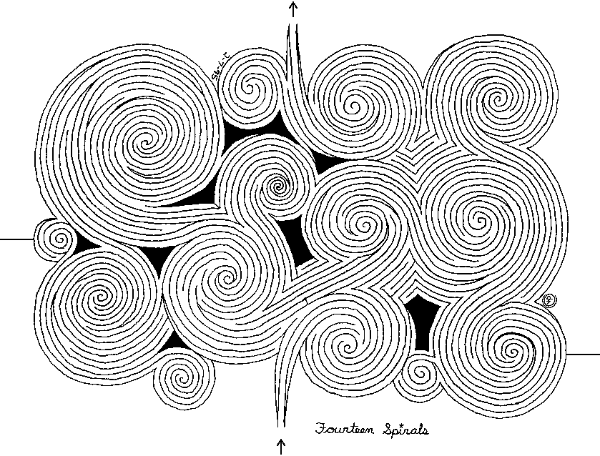
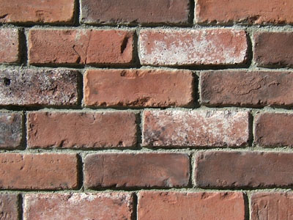
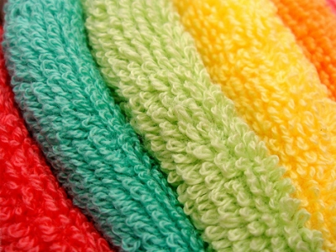
Texture
Texture: Texture is the surface quality of an object. A rock may be rough and jagged. A piece of silk may be soft and smooth and your desk may feel hard and smooth. Texture also refers to the way a picture is made to look rough or smooth.
Implied vs. Real

Slide 13
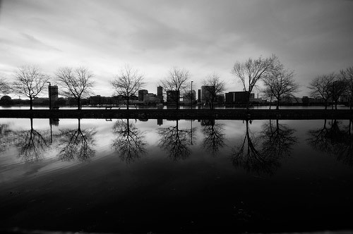
Value

Slide 14
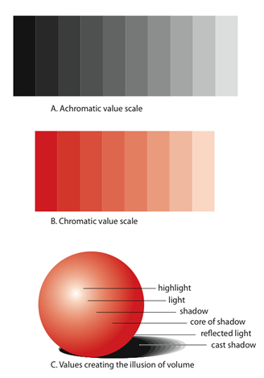
Value
Value is the range of lightness and darkness within a picture. Value is created by a light source that shines on an object creating highlights and shadows. Value creates depth within a picture making an object look three dimensional with highlights and cast shadows, or in a landscape where it gets lighter in value as it recedes to the background giving the illusion of depth
Tints, Shades, Highlights, Shadows

Slide 15
Color

Slide 16
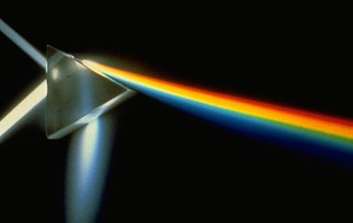
Color
Color comes form light; if it weren’t for light we would have no color. Light rays move in a straight path from a light source. Within this light rays are all the rays of colors in the spectrum or rainbow. Shining a light into a prism will create a rainbow of colors because it separates the color of the spectrum. When the light rays hits an object our eyes responds to the light that is bounced back and we see that color. For example a red ball reflects all the red light rays. As artist we use pigments in the form of powder or liquid paints to create color.

Slide 17
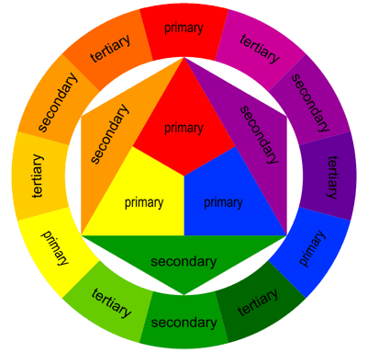
Color: Primary, Tertiary and Secondary

Slide 18
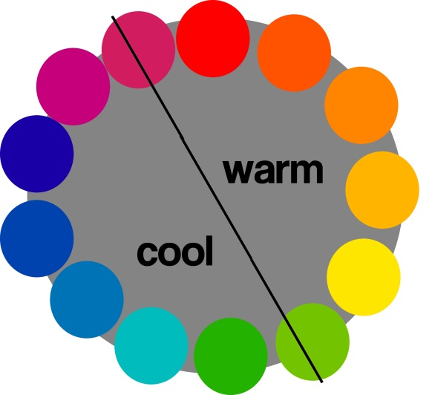
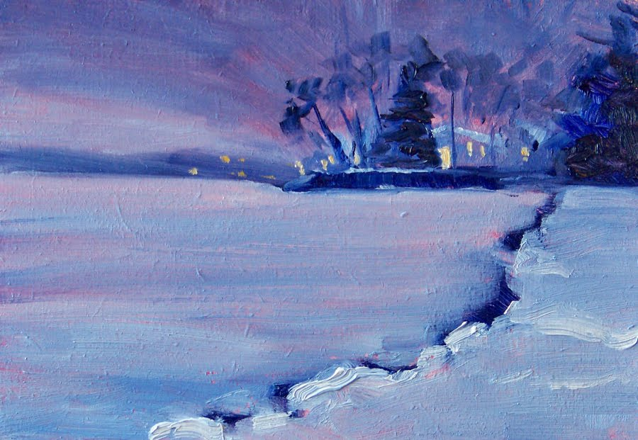
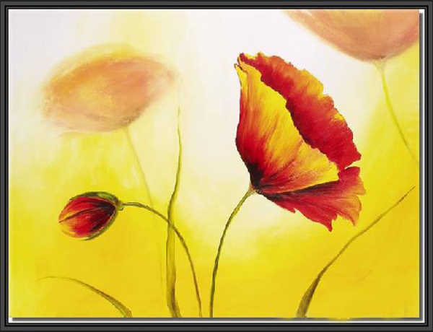
Warm Vs. Cool Colors

Slide 19
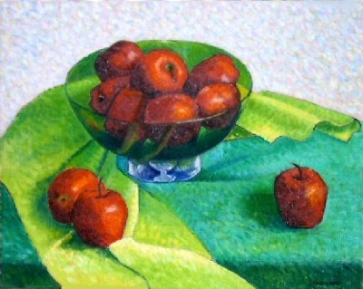
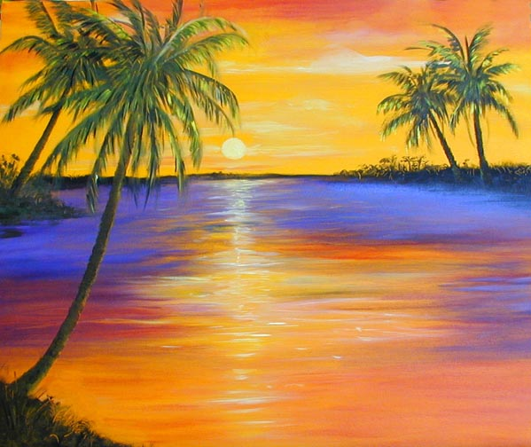
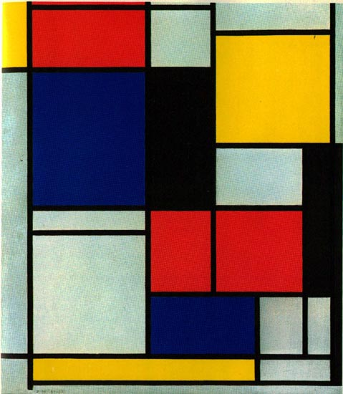
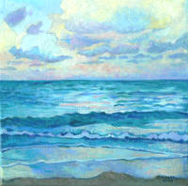
Color Schemes
Complementary Colors-are colors that are opposite each other on the color wheel. .
Analogous Colors are colors that are next to each other on the color wheel for example red, red orange, and orange are analogous colors.
Triadic is where three equally spaced colors on the color wheel are used for example, yellow, Red, Blue is a triadic harmony color scheme.
Monochromatic is where one color is used but in different values and intensity.

Slide 20
Principals of Design

Slide 21
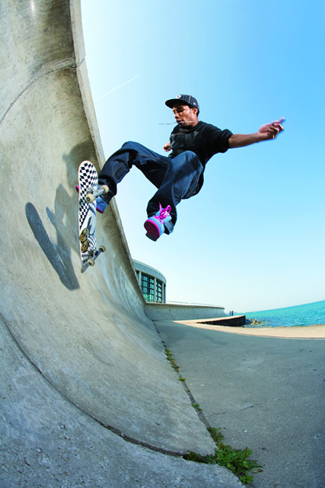
Balance

Slide 22
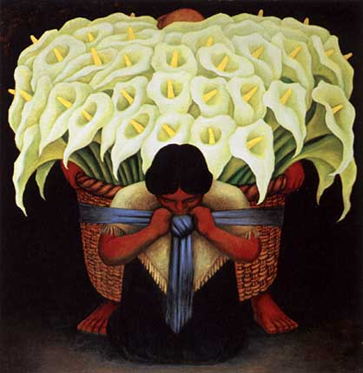
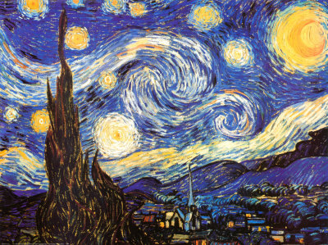
Balance
Balance is the stability of a picture. Most successful compositions achieve balance either through symmetrically or asymmetrically. Balance in a three dimensional object is easy to understand; if balance isn't achieved, the object tips over. To understand balance in a two dimensional composition, we must use our imaginations to carry this three dimensional analogy forward to the flat surface.

Slide 23
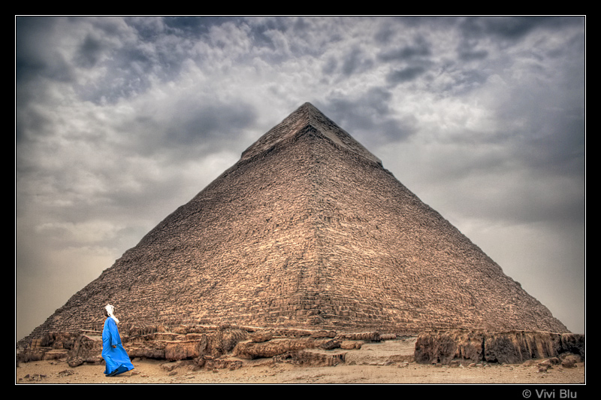
Contrast

Slide 24
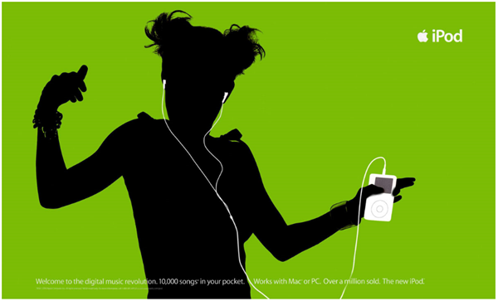
Contrast
Contrast means showing differences in two different sections of the design or showing somehow that the design being created is very different from other designs because of its contrast. Contrast can also be used to show emphasis in any part of the design.

Slide 25
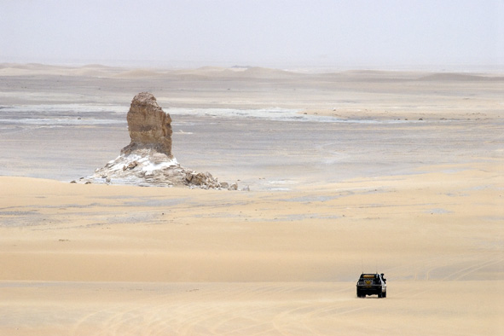
Proportion

Slide 26
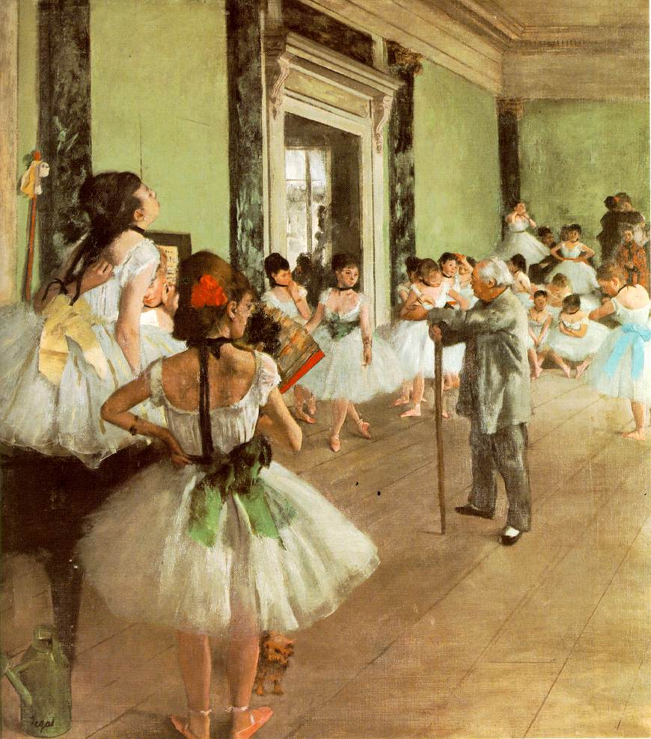
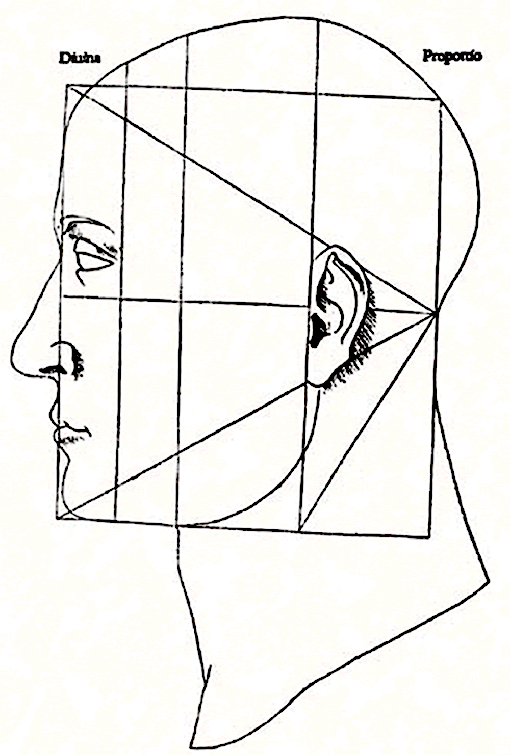
Proportion
Proportion refers to the relative size and scale of the various elements in a design. The issue is the relationship between objects, or parts, of a whole. This means that it is necessary to discuss proportion in terms of the context or standard used to determine proportions.

Slide 27
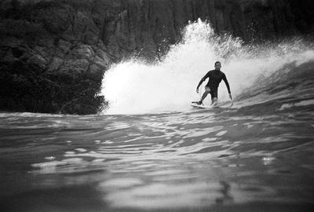
Emphasis

Slide 28
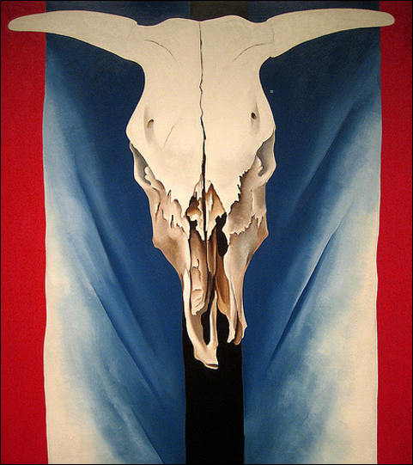
Emphasis
Emphasis: is an area that first attracts attention in a composition. This area is more important when compared to the other objects or elements in a composition. This can be by contrast of values, more colors, and placement in the format.

Slide 29
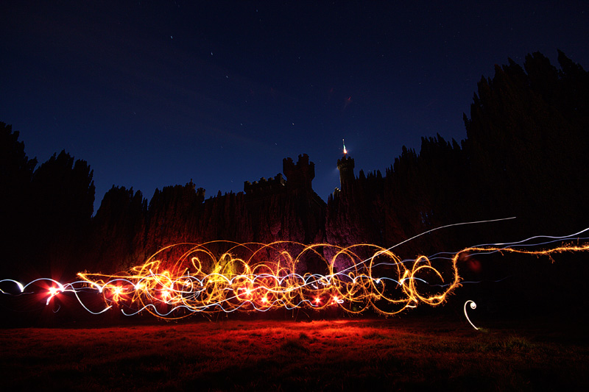
Rhythm and Movement

Slide 30
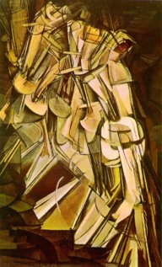
Rhythm and Movement
Directional Movement - is a visual flow through the composition. It can be the suggestion of motion in a design as you move from object to object by way of placement and position. Directional movement can be created with a value pattern. It is with the placement of dark and light areas that you can move your attention through the format. Rhythm - is a movement in which some elements recurs regularly. Like a dance it will have a flow of objects that will seem to be like the beat of music

Slide 31
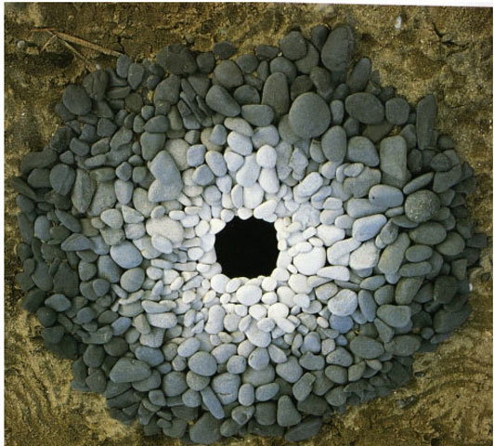
Unity

Slide 32
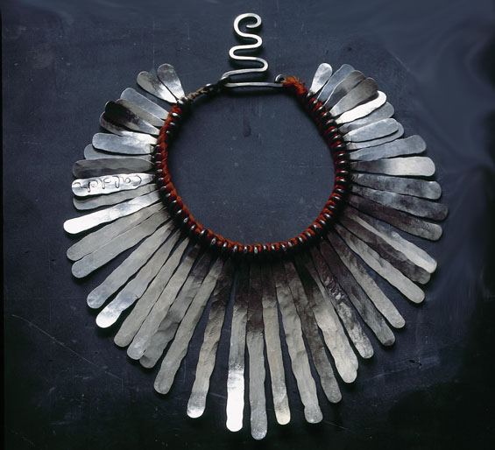
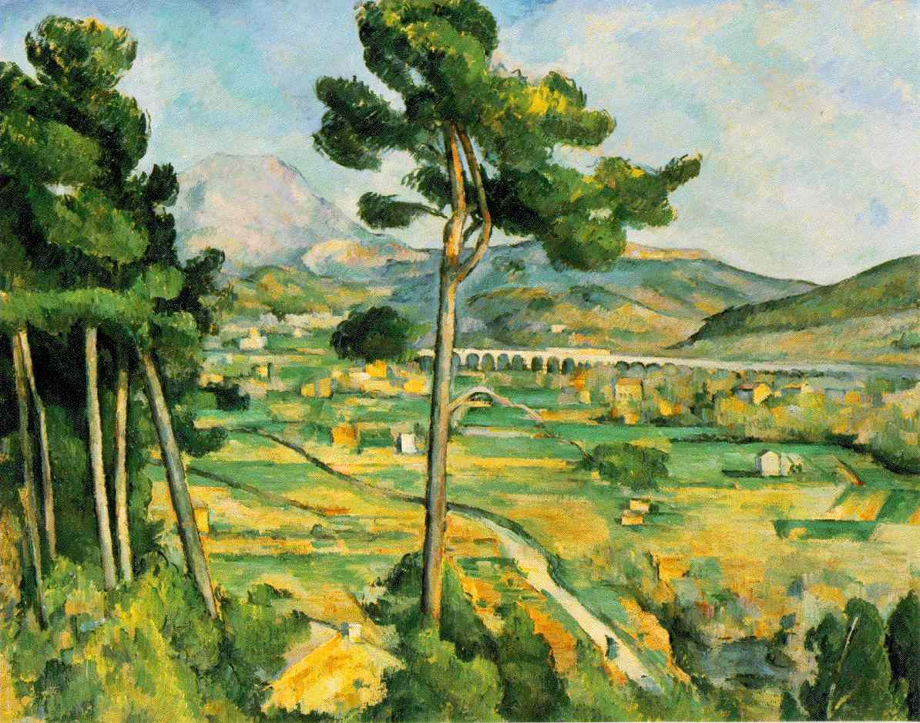
Unity
Unity: brings together a composition with similar units. If your composition was using wavy lines and organic shapes you would stay with those types of lines and not put in just one geometric shape.

